Slide 1
ProFolio
Phase II - Review 1
Under the guidance of
Prof. Aparna .M
Computer Science Department Dayananda Sagar College of Engineering.
Neethu R A [1DS19CS729]
Jisha Cheriyan [1DS19CS720]
Prema V [1DS19CS735]
Anurag Raj [1DS19CS027]

Slide 2

INTRODUCTION TO THE PROBLEM:
It's difficult for students to stay in the competition and to get a job they have to be skilled with new and upcoming technologies. They need to be aware of the new trends and technologies in the market. They have to build a lot of projects, contribute to open source, participate in hackathons and build their portfolio/resume. This becomes overwhelming to the students very quickly. So, we are building an online platform for students where they can learn, get guidance, be up-to-date with new trends and technologies.

Slide 3
Contribution of Each project Members
Name: Neethu R A Name: Jisha Cheriyan Name: Prema V Name: Anurag Raj
USN:1DS19CS729 USN:1DS19CS720 USN:1DS19CS735 USN:1DS19CS027
Contribution: Contribution: Contribution: Contribution:

Slide 4
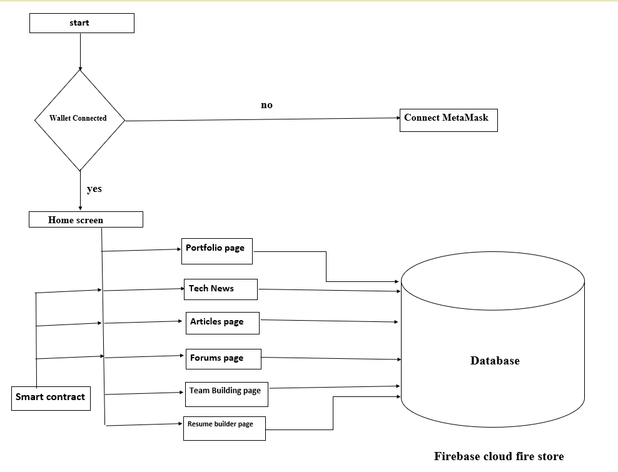
SYSTEM DIAGRAM / ARCHITECTURE:

Slide 5





Modules:
1. Portfolio
2. Discussion Forums
3. Articles
4. Tech news
5.Team building
6. Resume Builder

Slide 6
Modules Descriptions:
1.Students can showcase their projects and skills to everyone including students professors and potential hiring managers.
2.Students working on projects can make them opensource and other students will be able to contribute to it including an opensource environment in the college.
3.Students will write and publish articles/blog.
4.There will be discussion forums for all topics. Students can join any of these forums to get more knowledge. Ask doubts in specific forums to get quick relevant solutions.
5.Students looking for team members for a hackathon or other team based competition/events can come here to find the perfect team mates.
6.Students can create their resumes according to industry standards from this page. The resume will be filled with information from the portfolio page and profile page.

Slide 7
INPUT:

Slide 8

ALGORITHM:

Slide 9

OUTPUT:
By the end of the project we will be implementing a profile/portfolio page for every student, a page where all the open-source projects from DSCE students will be showcased. students interested can start contributing to these projects, a place where students can write and host articles which can be monetized, Discussion forums for various topics, a Feed page where students can post anything, an ask the expert/senior section, a team building page for hackathons, a News and trends page, a Resume Builder, a page with Freelance opportunities for students

Slide 10
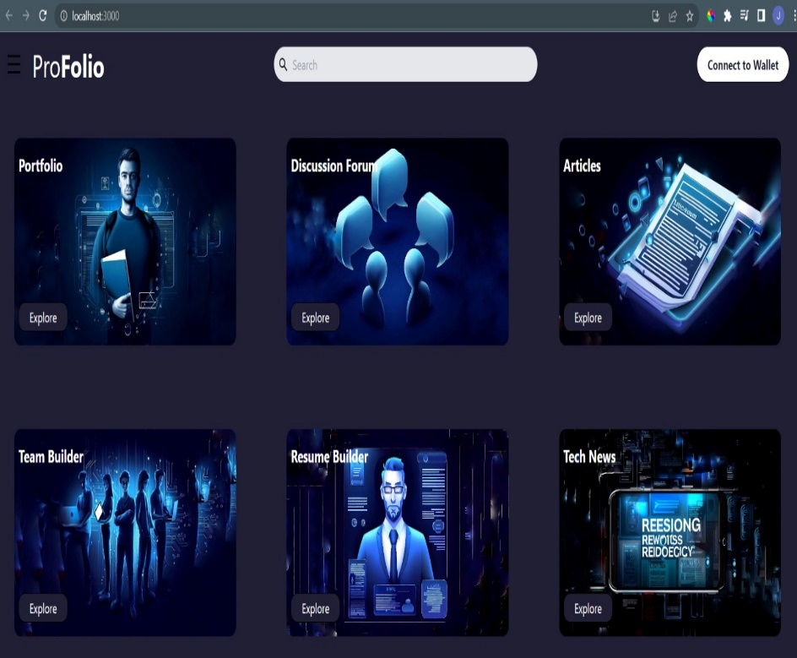
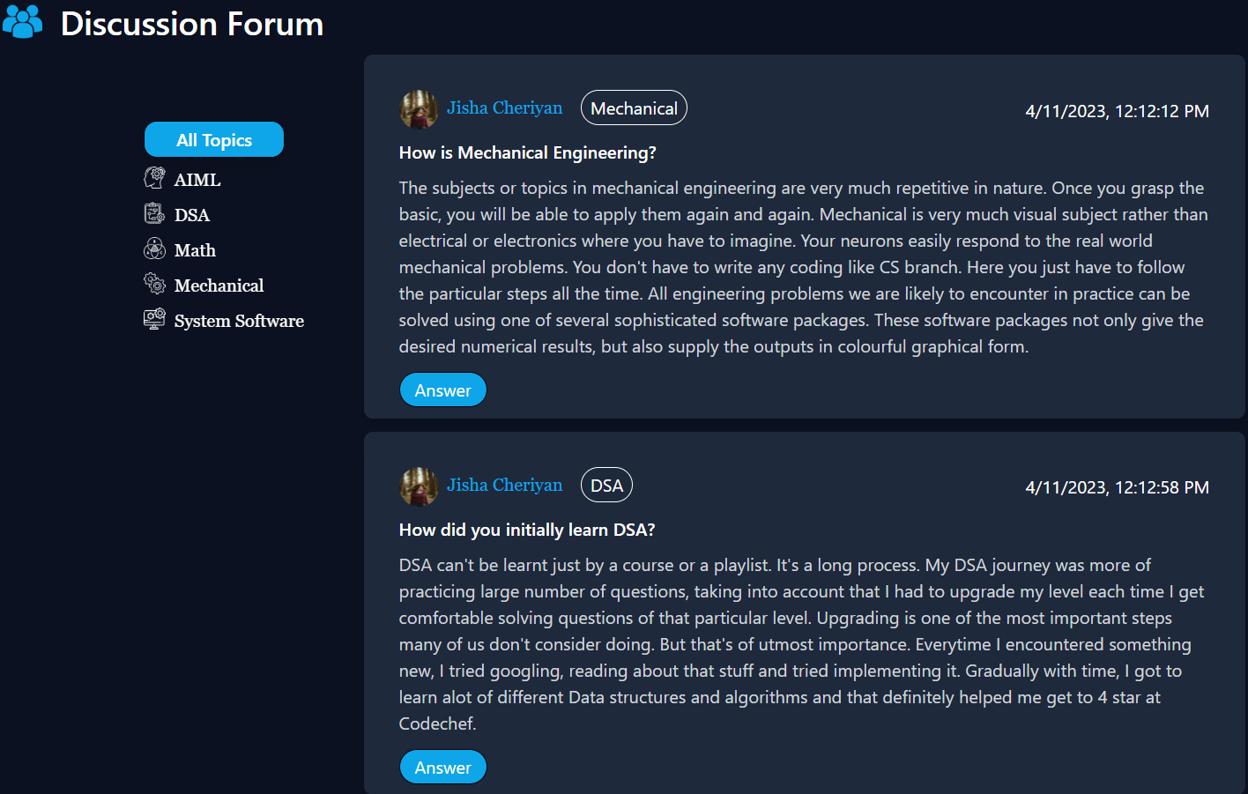
GUI DESIGN:
We have developed a website as the GUI of our project.

Slide 11
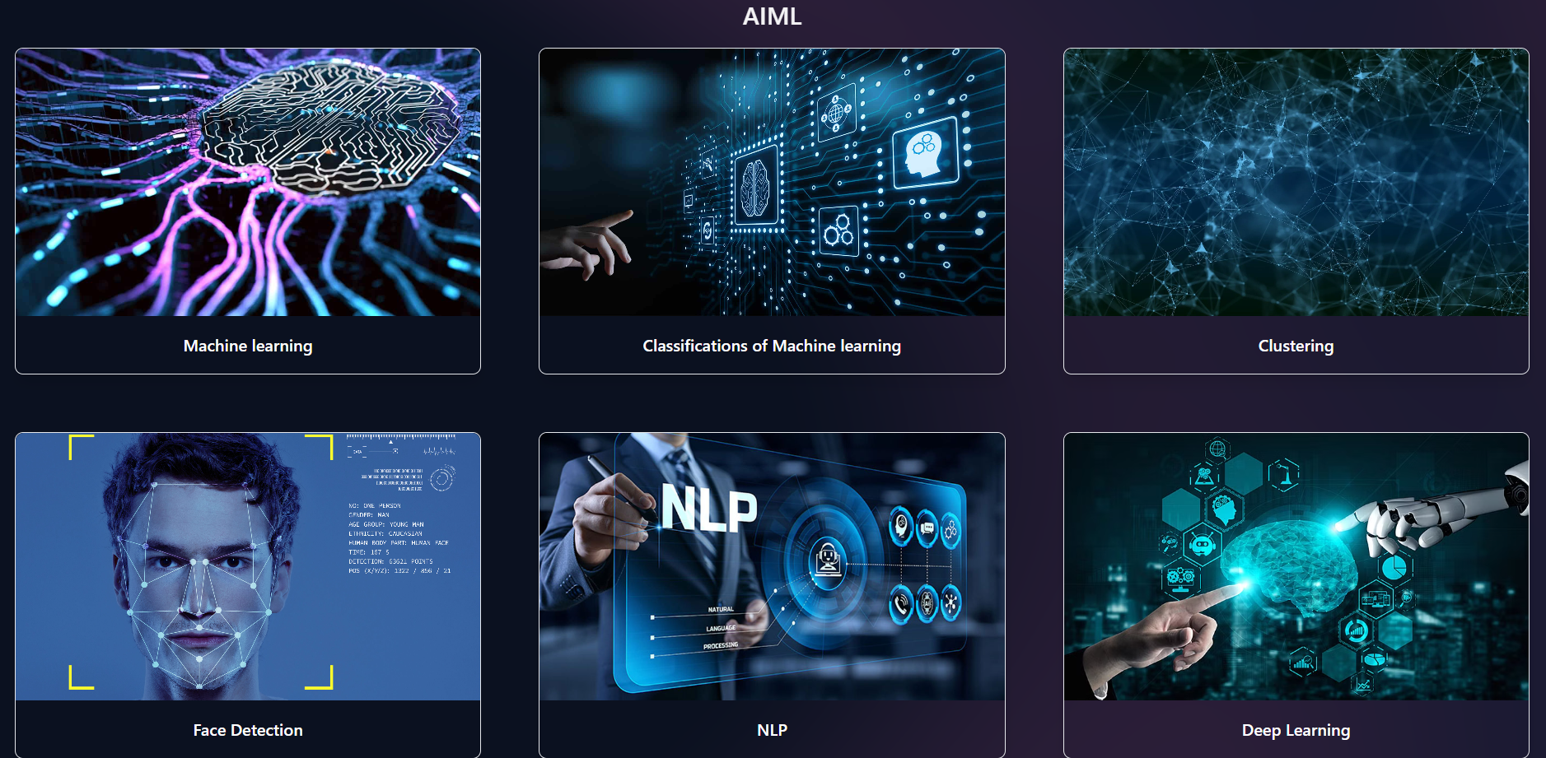
GUI DESIGN:

Slide 12
Co-Guide Meet Details

Slide 13
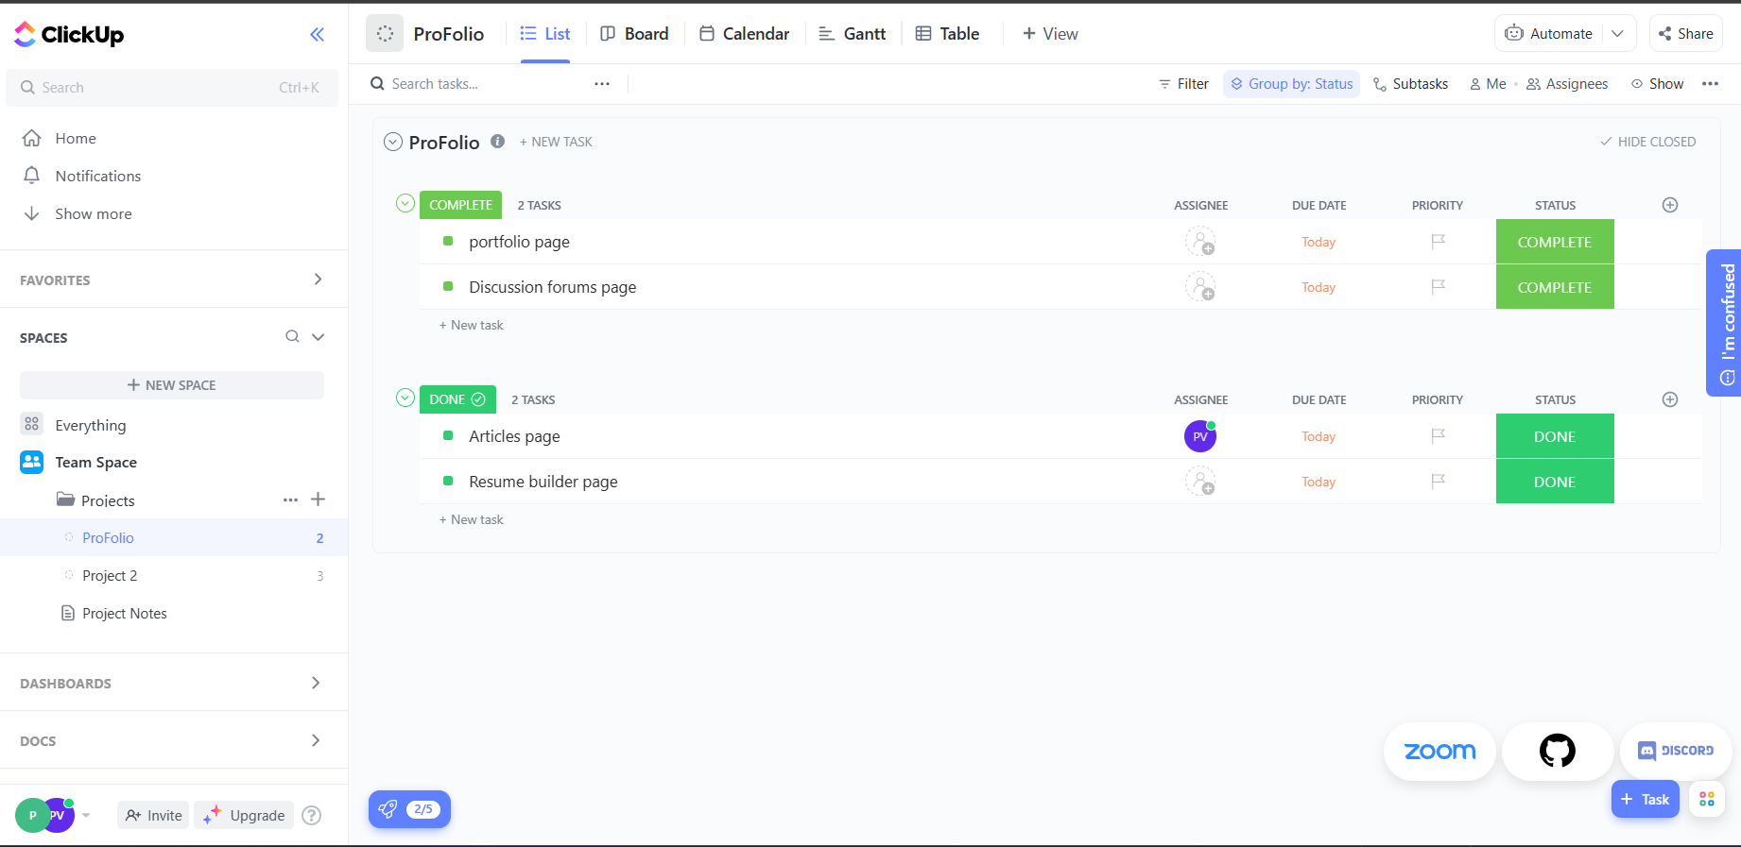
PROJECT TOOL SNAPSHOT:

Slide 14
THANK YOU!

